Slide 1
Project Status
GPS Jammer Detection

Slide 2
Marketing Requirements
Receive I/Q data
Determine if a civilian GPS jamming signal is present
Notify the user that a jammer has been detected

Slide 3
Project Deliverables
GPS jammer detection program that can detect one method of jamming
source code
Test bench

Slide 4
Project Schedule
Design requirements (Done)
Gantt Chart (Done)
Software Design (In Progress)
Modular Testing (In Progress)
Test Plan (In Progress)
Notes:
Is the project on time
List issues that cause the project to be falling behind schedule
A)limited FPGA knowlage
B)Limited integrated systems knolage

Slide 5
Definition:
Jamming Signals: signals are continuous presenting more than on second and with transmitted power is greater than -60dBm to be an effective jamming signals.
Chirp Signal: A chirp is a signal in which the frequency increases ('up-chirp') or decreases ('down-chirp') with time and repeats periodically.
Continuous Wave: A signal with constant amplitude and frequency.
Note: If multi-frequency jammers transmitted signals characterized by the same sweep period in each frequency band. This considers to be that a single local oscillator is used for the generation of all the signals.

Slide 6
Detector Algorithm Design
Trigger is used to start detector when threshold is crossed
Wide RBW FFTs allow the user to see single peak frequencies
Peak frequencies can be tracked over time to measure chirp rate and bandwidth
Signal can be auto correlated with a predicted signal
If auto correlated signal is used to determine jamming

Slide 7
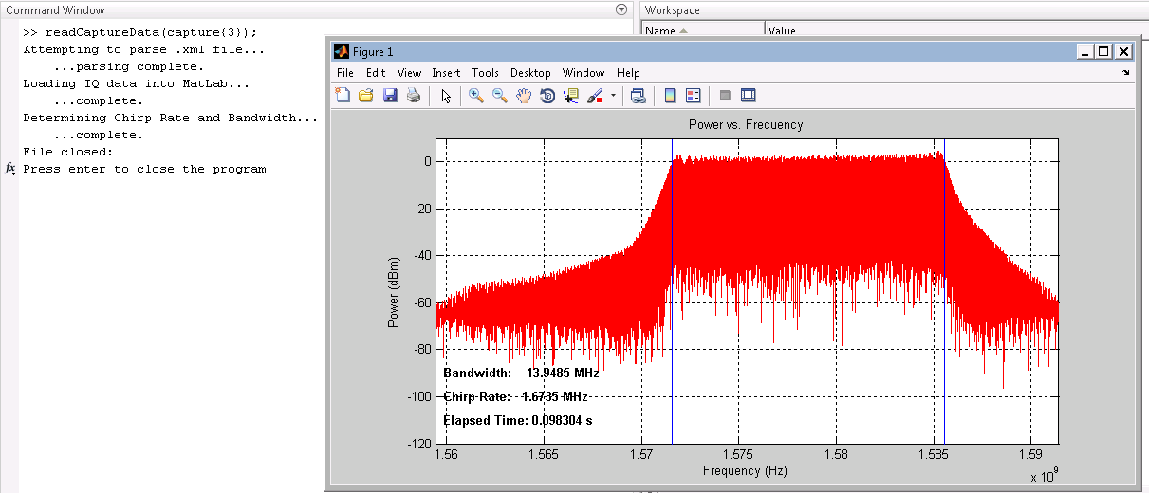
Reading the Jammer Captures into MatLab
Metadata is read from the XML file
IQ data is read into a matrix
Data is transformed and plotted in frequency domain

Slide 8
Chirp and CW Detectors
The detector algorithm is triggered if it detects a peak above -50dBm
Jammer bandwidth is calculated by recording the max and min frequency over time
Chirp rate is calculated by computing an FFT of the frequency vs. time data
If chirp BW is sufficiently small, we can assume it’s a CW signal

Slide 9
Attenuator Program
Inputs float 32 file
Requests an amount to attenuate the program by in dBm
Saves attenuated matrix as float 32
Notes:
File convers data into mag phase adds noise and attenuates the signal,
Converts back into float32

Slide 10
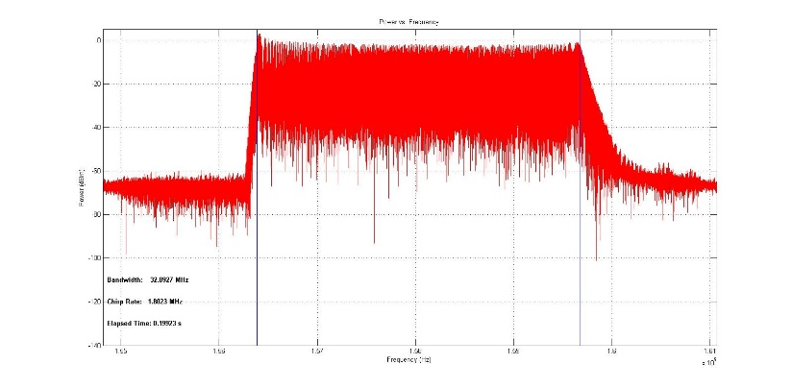
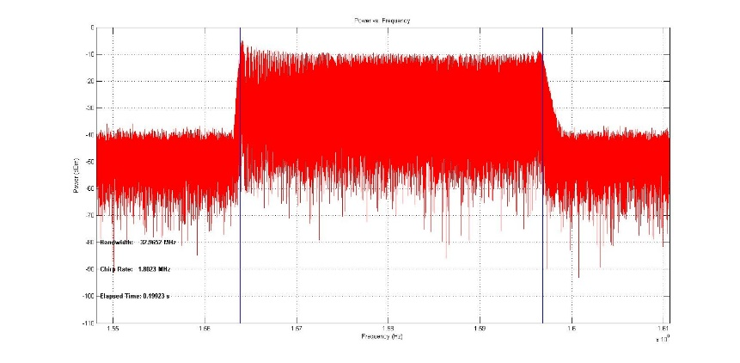
Attenuation 0 dBm vs 10 dBm
0 dBm Attenuation
10 dBm Attenuation

Slide 11
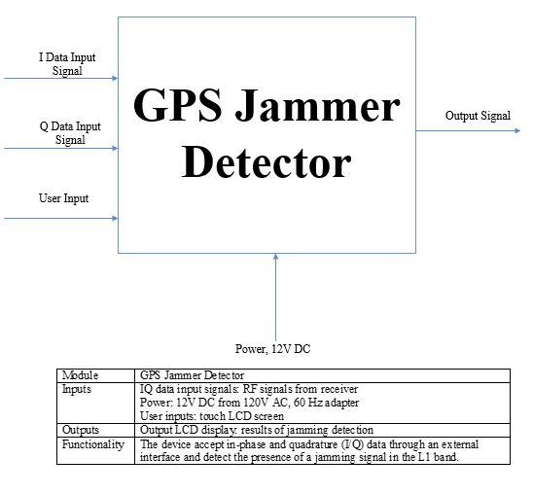
GPS Jammer Detector

Slide 12
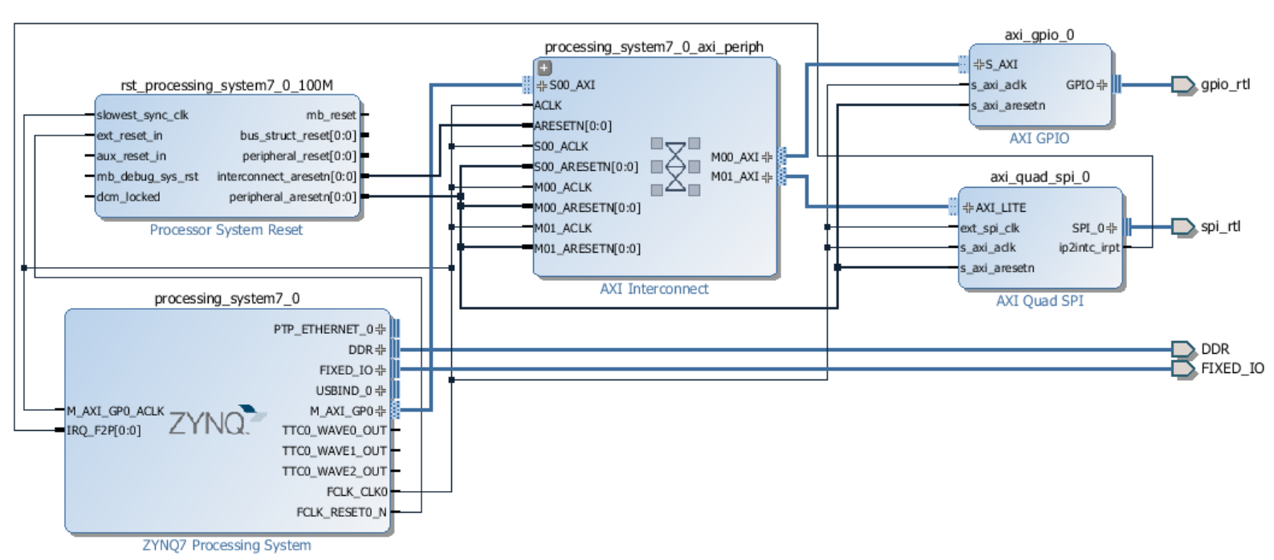
FPGA Hardware Setup

Slide 13
Bill of Materials
Notes:
Project estimated cost
Items that need to be ordered and delivery date.

